Slide 1
Confluent Kafka
Deep Dive Sessions
By: Gaurav Sharma

Slide 2
Confluent cluster architecture
https://richiebachala.medium.com/11-steps-for-understanding-confluent-kafka-for-data-engineers-47ab9a398bed

Slide 3
Zookeeper ensemble
Zookeeper cluster is called ensemble.
Odd number of servers (typically 3 or 5)
All servers need to have common configuration file
Quorum : majority of the servers should be running to form a quorum
Configurations:
tickTime:2000
dataDir:/var/lib/zookeeper
clientPort:2181
Server1 : hostname: peerPort: leaderPort
Server2
Server3
initTime : the amount of time to allow followers to connect
syncLimit : value limits how long out-of-sync followers can be with the leader

Slide 4
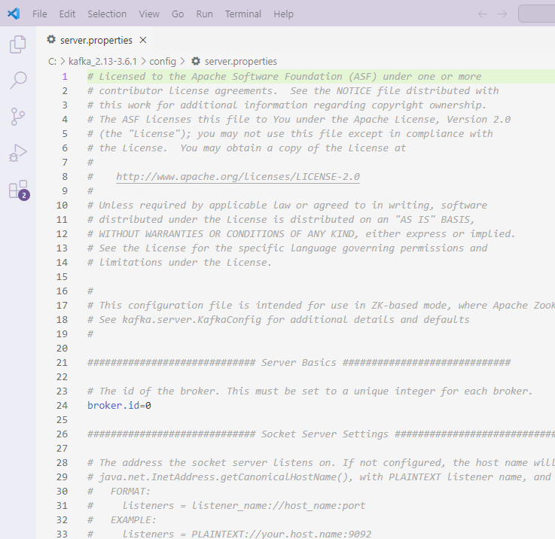
Kafka internals
Cluster membership
Each broker has a numeric broker id , mentioned in the config file.
Broker registers itself with the zookeeper using this id creating ephemeral node
Each broker in a cluster has unique id
The first broker to register itself with the zookeeper becomes controller.
If controller goes down, other brokers attempt to become controller
Controller helps in selecting leader partitions.
Zookeeper selects controller and stores metadata (brokers, topics, partition, replicas)

Slide 5
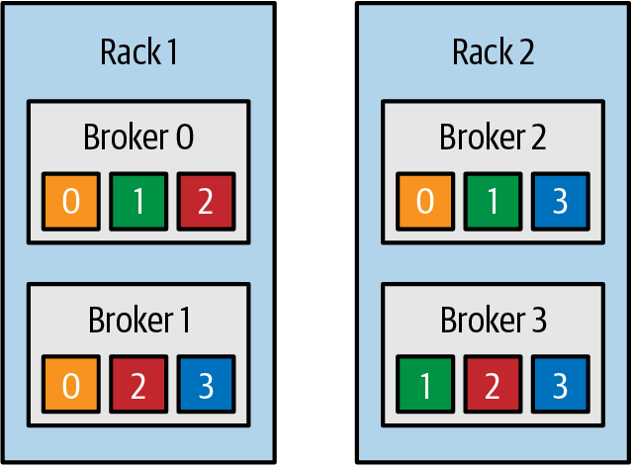
Partition allocation
Assume 4 brokers, new topic with 4 partitions and a replication factor of 3

Slide 6

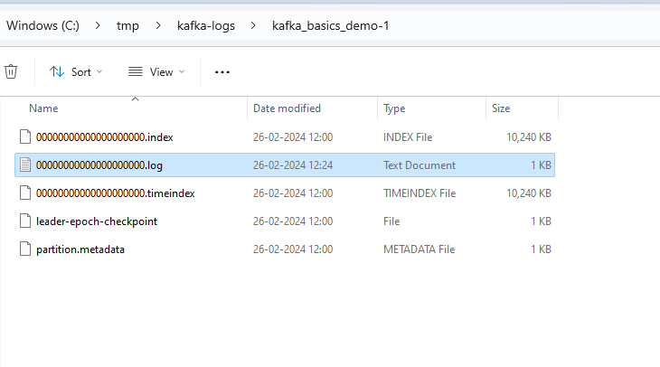
File management
Directories
Topic is divided into partitions, partition is divided into segments for the purpose of writing data to the disk. Segment file can be retained for time duration or based size limit.
Active segment is not deleted.
If fewer messages are expected, retention should be maintained on time basis

Slide 7
Kafka connect architecture
Connect cluster
Kafka cluster
Source
Streams App
Worker1
Broker1
Worker2
Broker2
Sink
Stream App
Worker3
Broker3

Slide 8
Kafka connect concepts
Source connector gets data from common data source to Kafka
Sink connectors publish data from Kafka to common data sources
Reusable code , can be configured easily
Tasks are created by connector configuration
Workers are the servers. Tasks are created within workers
Standalone mode of connect cluster: For development
Distributed mode: Provides REST API , used for production
All workers have same group id within a connect cluster
Number of active tasks of a sink connector equals number of topic partitions

Slide 9
Kafka Streams concepts
A stream is an ordered, replayable, and fault-tolerant sequence of immutable data records, where a data record is defined as a key-value pair.
A stream processing application is any program that makes use of the Kafka Streams library.
Processor topology is a graph of stream processors (nodes) that are connected by streams (edges)
Stream processing application defines its computational logic through one or more processor topologies

Slide 10
Kafka Streams concepts
Source Processor: A source processor is a special type of stream processor that does not have any upstream processors. It produces an input stream to its topology from one or multiple Kafka topics by consuming records from these topics and forwarding them to its down-stream processors.
Sink Processor: A sink processor is a special type of stream processor that does not have down-stream processors. It sends any received records from its up-stream processors to a specified Kafka topic.

Slide 11
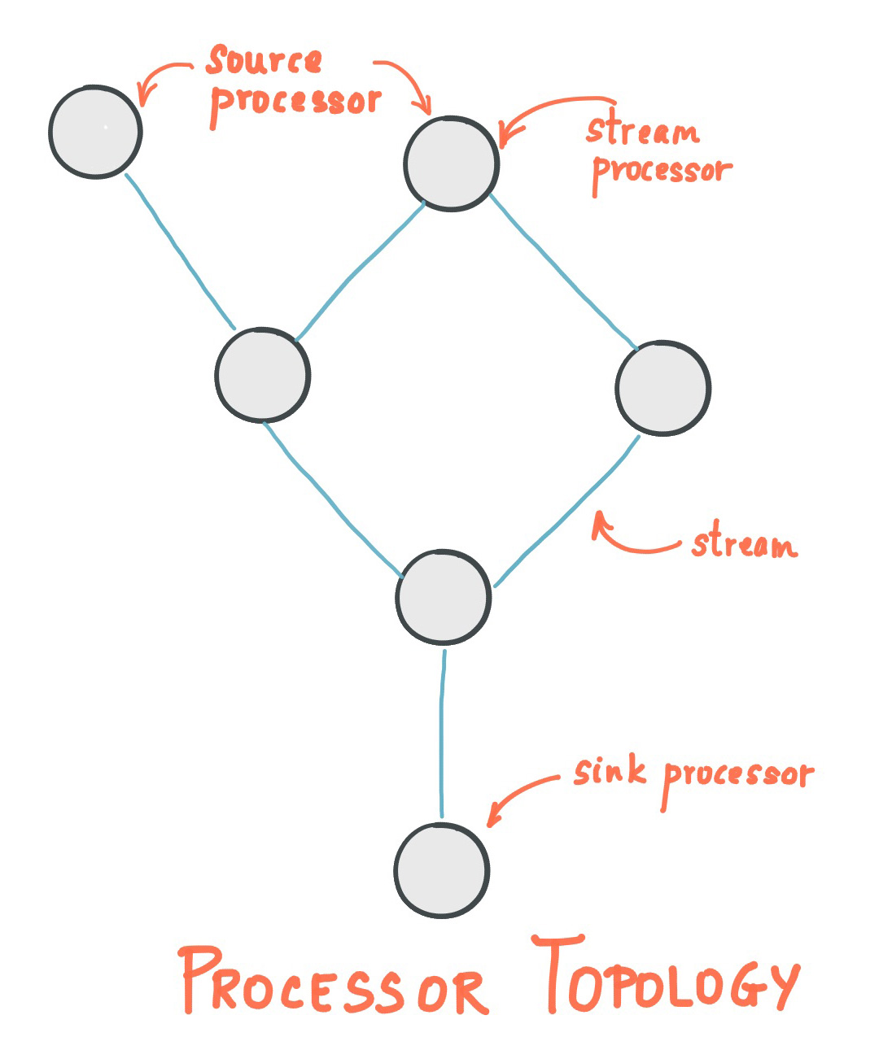
Kafka Streams concepts

Slide 12
Kafka Streams concepts
Kafka Streams offers two ways to define the stream processing topology:
the Kafka Streams DSL provides the most common data transformation operations such as map, filter, join and aggregations out of the box;
the lower-level Processor API allows developers define and connect custom processors as well as to interact with state stores.

Slide 13
Streams DSL (Domain Specific Language)
https://kafka.apache.org/37/documentation/streams/developer-guide/dsl-api.html#id9
Create source stream -> Transform stream -> Write back
Built in abstraction for streams and tables : Kstream , Ktable, GlobalKTable
Kstream
Continuous unbounded stream of records
Represents changelog with each record is an INSERT

Slide 14
Streams DSL
With the DSL, you can define processor topologies (i.e., the logical processing plan) in your application. The steps to accomplish this are:
Specify one or more input streams that are read from Kafka topics.
Compose transformations on these streams.
Write the resulting output streams back to Kafka topics, or expose the processing results of your application directly to other applications through interactive queries (e.g., via a REST API).

Slide 15
Streams DSL
Ktable:
Abstraction of a changelog stream, where each data record represents an update
Each record is an UPSERT
A record with null value represents DELETE
Provides ability to lookup current values
GlobalKTable
Each record of the Ktable is stored locally
More efficient joins but more storage required
When joining against a global table, the input data does not need to be co-partitioned.

Slide 16
Streams DSL
Read input topic
As Kstream
As Ktable
As GlobalKTable
Transform a stream
Stateless transformation
Stateless transformations do not require state for processing and they do not require a state store associated with the stream processor. E.g., Filter, FlatMap, FlatMapValues, Foreach, GroupBy, Map etc.

Slide 17
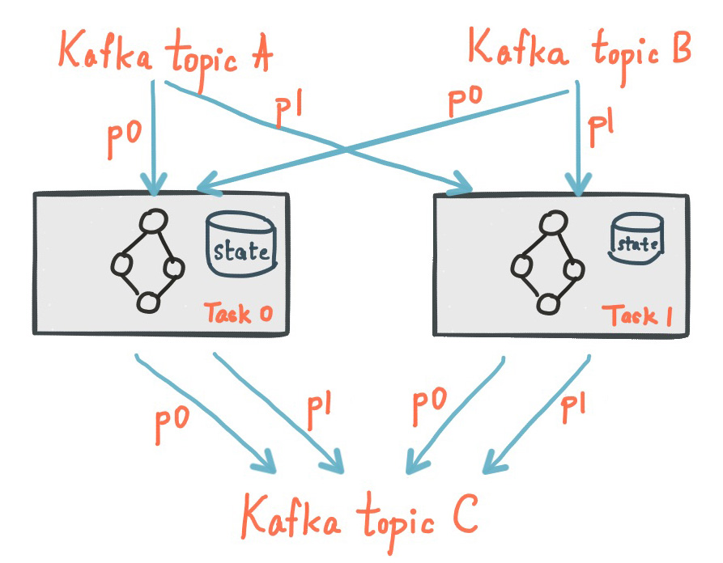
Streams DSL
Stateful transformation
Stateful transformations depend on state for processing inputs and producing outputs and require a state store associated with the stream processor. E.g., Aggregation, Joining.
Non-windowed aggregation/joins
Windowed aggregation/joins

Slide 18
Streams DSL
Aggregation
key-based operations, which means that they always operate over records (notably record values) of the same key
aggregations on windowed or non-windowed data
Joining
Streams and tables can also be joined. Many stream processing applications in practice are coded as streaming joins. For example, applications backing an online shop (stream joins instead of DB lookup are faster)
Depending on the operands, joins are either windowed joins or non-windowed joins.
For equi-joins, input data must be co-partitioned when joining. Co-partitioning is not required when performing KTable-KTable Foreign-Key joins and Global KTable joins.

Slide 19
Joins
Join operands | Type | (INNER) JOIN | LEFT JOIN | OUTER JOIN
KStream-to-KStream | Windowed | Supported | Supported | Supported
KTable-to-KTable | Non-windowed | Supported | Supported | Supported
KTable-to-KTable Foreign-Key Join | Non-windowed | Supported | Supported | Not Supported
KStream-to-KTable | Non-windowed | Supported | Supported | Not Supported
KStream-to-GlobalKTable | Non-windowed | Supported | Supported | Not Supported
KTable-to-GlobalKTable | N/A | Not Supported | Not Supported | Not Supported

Slide 20
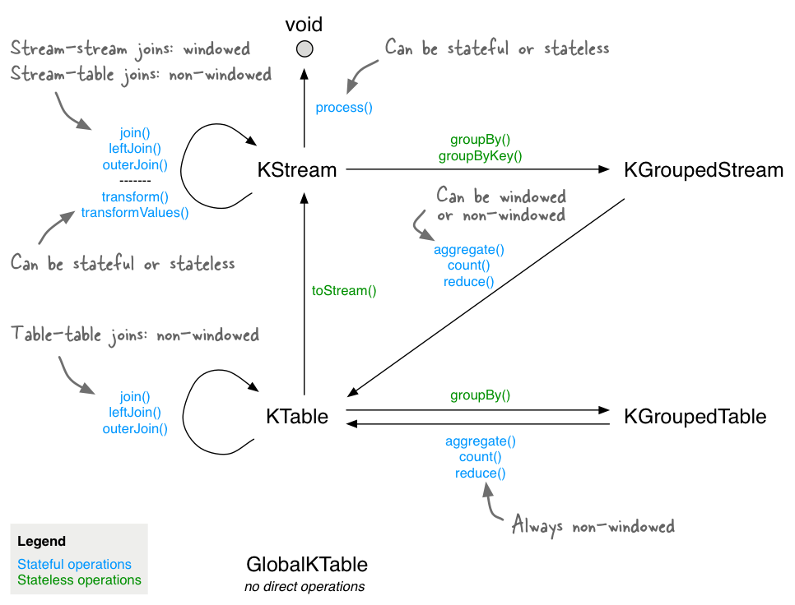
Stateful and stateless

Slide 21
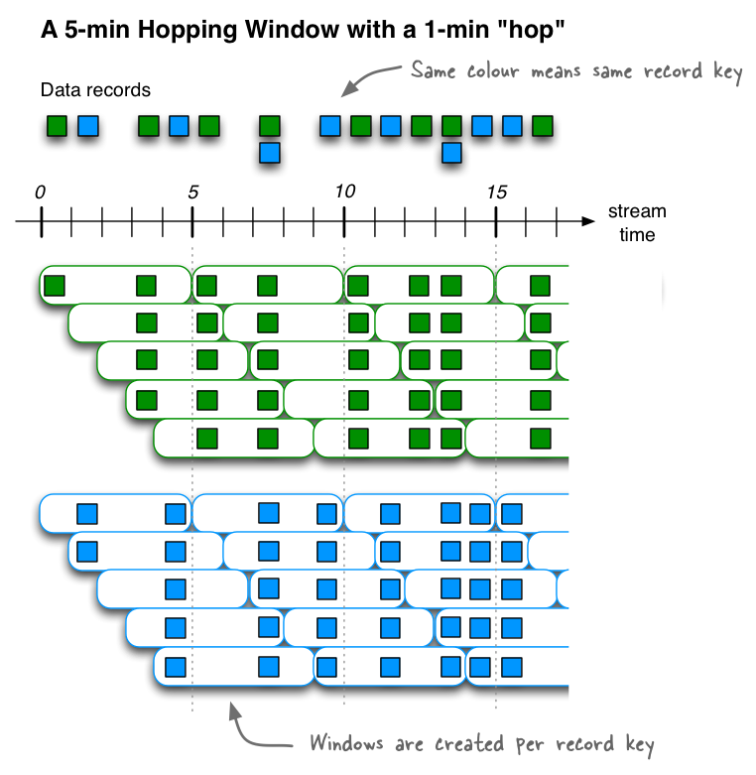
Windows
Hopping window

Slide 22
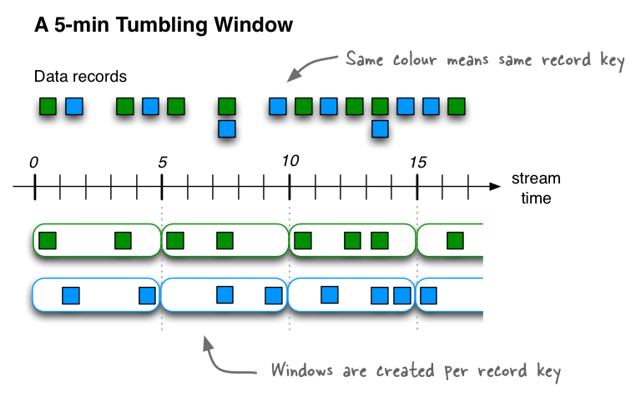
Windows
Tumbling windows

Slide 23
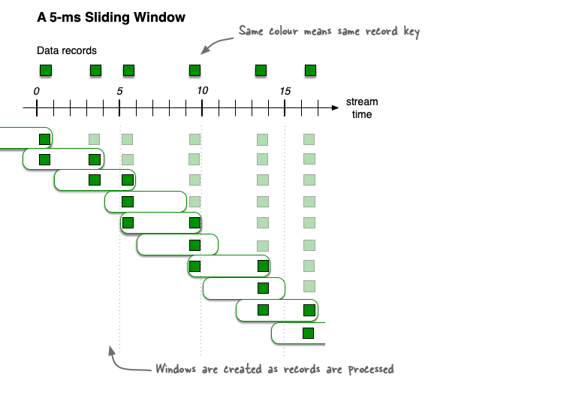
Windows
Sliding window (works on difference b/w record timestamp)

Slide 24
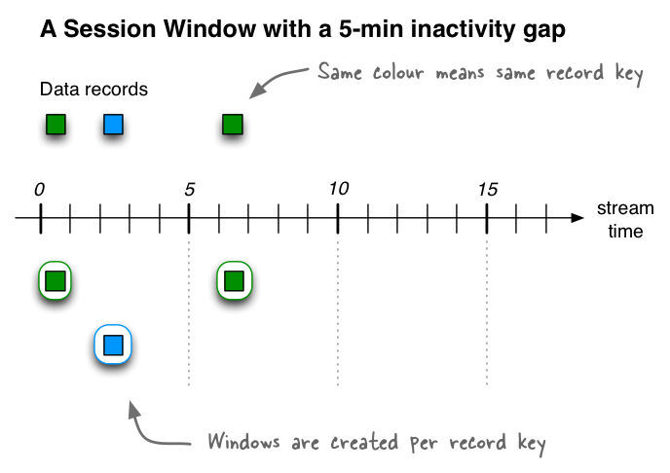
Windows
Session windows

Slide 25
Streams DSL
Writing stream back to Kafka
stream.to("my-stream-output-topic", Produced.with(Serdes.String(), Serdes.Long());

Slide 26
KSQL DB
https://docs.ksqldb.io/en/latest/developer-guide/ksqldb-reference/
https://docs.ksqldb.io/en/latest/operate-and-deploy/how-it-works/

Slide 27
Schema Registry
Producer
Avro records
Kafka Cluster
Avro records
Consumer
Register schema
Retrieve schema
Schema Registry

Slide 28
Schema Registry
Producer creates the record
Producer serializes the record using Avro serializer and adds the schema id
Consumer uses Avro deserializer, schema registry url and schema id to deserialize the record
Consumer processes the record

Slide 29
Schema Registry
Schema Registry provides the following services:
Allows producers and consumers to communicate over a well-defined data contract in the form of a schema
Controls schema evolution with clear and explicit compatibility rules
Optimizes the payload over the wire by passing a schema ID instead of an entire schema definition
At its core, Schema Registry has two main parts:
A REST service for validating, storing, and retrieving Avro, JSON Schema, and Protobuf schemas
Serializers and deserializers that plug into Apache Kafka® clients to handle schema storage and retrieval for Kafka messages across the three formats

Slide 30
Schema Registry
Schema
defines the structure of message data.
acts as a blueprint for data,
describes the structure of data records, the data types of individual fields, the relationships between fields, and any constraints or rules that apply to the data.
used in various data processing systems, including databases, message brokers, and distributed event and data processing frameworks.
ensure that data is consistent, accurate, and can be efficiently processed and analyzed by different systems and applications

Slide 31
Schema Registry
Compatibility and schema evolution
There is an implicit “contract” that producers write data with a schema that can be read by consumers, even as producers and consumers evolve their schemas.
Schema Registry helps ensure that this contract is met with compatibility checks.
It is useful to think about schemas as APIs
Schema evolution requires compatibility checks to ensure that the producer-consumer contract is not broken. This is where Schema Registry helps: it provides centralized schema management and compatibility checks as schemas evolve.

Slide 32
Schema Registry
Data serialization
process of converting data structures or objects into a format that can be transmitted across a network or stored in a file.
Confluent Schema Registry supports Avro, JSON Schema, and Protobuf serializers and deserializers (serdes).
Serdes handle the details of the wire format for you, so you don’t have to worry about how messages are mapped to bytes.

Slide 33
Schema Registry
Topic vs Schema vs Subject
Topic : contains messages, and each message is a key-value pair.
Either the message key or the message value, or both, can be serialized as Avro, JSON, or Protobuf
A schema defines the structure of the data format. The Kafka topic name can be independent of the schema name.
Schema Registry defines a scope in which schemas can evolve, and that scope is the subject (by default is set to derive subject name from topic name)

Slide 34
Schema Registry
Example use case
Topic name : transactions
Schema name : Payment
Producer serializes both key and value
Subject names: transactions-key , transactions-value
Schemas evolve within the scope of subjects (version 1, 2 etc.)

Slide 35
Schema Registry
Avro schema example
{
"namespace": "io.confluent.examples.clients.basicavro",
"type": "record",
"name": "Payment",
"fields": [
{"name": "id", "type": "string"},
{"name": "amount", "type": "double"}
]
}
namespace: a fully qualified name that avoids schema naming conflicts
type: Avro data type, for example, record, enum, union, array, map, or fixed
name: unique schema name in this namespace
fields: one or more simple or complex data types for a record. The first field in this record is called id, and it is of type string. The second field in this record is called amount, and it is of type double.

Slide 36
Schema Registry
Schema registry API
To view all the subjects registered in schema registry
http://localhost:8081/subjects/
To view the latest schema for this subject in more detail
http://localhost:8081/subjects/transactions-value/versions/latest
{
"subject": "transactions-value",
"version": 1,
"id": 1,
"schema": "{\"type\":\"record\",\"name\":\"Payment\",\"namespace\":\"io.confluent.examples.clients.basicavro\",\"fields\":[{\"name\":\"id\",\"type\":\"string\"},{\"name\":\"amount\",\"type\":\"double\"}]}"
}

Slide 37
Schema Registry
subject: the scope in which schemas for the messages in the topic transactions can evolve
version: the schema version for this subject, which starts at 1 for each subject
id: the globally unique schema version id, unique across all schemas in all subjects. (The version will always be incremented if you make a compatible schema change. If your edit to the subject schema happens to match some other subject schema definition, then the ID wouldn't change. If the schema matches some other schema in any other subject, id would be same)
schema: the structure that defines the schema format
Get schema based on id:
http://localhost:8081/schemas/ids/1

Slide 38
Schema Registry
Schema Id in messages
Kafka messages do not need to be written with the entire Avro schema. Instead, Kafka messages are written with the schema id.
The producers writing the messages and the consumers reading the messages must be using the same Schema Registry to get the same mapping between a schema and schema id.
Producer and consumers cache schema id on subsequent message write/reads

Slide 39
Schema Registry
Schema registration
By default, client applications automatically register new schemas. If they produce new messages to a new topic, then they will automatically try to register new schemas.
you can disable automatic schema registration by setting the configuration parameter auto.register.schemas=false
The option auto.register.schemas must be set to false in order for use.latest.version to work in producers
To manually register the schema outside of the application, you can use Control Center or connect directly to the REST endpoint in Schema Registry (post to http://localhost:8081/subjects/demo_topic-value/versions)

Slide 40
Schema Registry
Schema evolution and compatibility check
Schema Registry allows for schema evolution and provides compatibility checks to ensure that the contract between producers and consumers is not broken.
If compatibility is configured as transitive, then it checks compatibility of a new schema against all previously registered schemas; otherwise, it checks compatibility of a new schema only against the latest schema.
The Confluent Schema Registry default compatibility type BACKWARD is non-transitive, which means that it’s not BACKWARD_TRANSITIVE. As a result, new schemas are checked for compatibility only against the latest schema.

Slide 41
Schema Registry
Compatibility types (assume schema version V1,V2,V3)
BACKWARD: (default) consumers using the V3 can read data written by producers using the V2 schema
BACKWARD_TRANSITIVE: consumers using the V3 can read data written by producers using all previously registered schemas(V1,V2)
FORWARD: consumers using the (V3) can read data written by producers using the new schema
FORWARD_TRANSITIVE: consumers using all previously registered schemas can read data written by producers using the V3
FULL: V3 is forward and backward compatible with the V2
FULL_TRANSITIVE: the new schema is forward and backward compatible with all previously registered schemas
NONE: schema compatibility checks are disabled

Slide 42
Schema Registry
To maintain backward compatibility, a new schema must assume default values for the new field if it is not provided.
{
"namespace": "io.confluent.examples.clients.basicavro",
"type": "record",
"name": "Payment",
"fields": [
{"name": "id", "type": "string"},
{"name": "amount", "type": "double"},
{"name": "region", "type": "string", "default": ""}
]
}
Adding a new field in Avro schema is a forward compatible change. Deleting an existing field or renaming a field is not forward compatible.

Slide 43
Authentication and authorization
Authentication : establish identity
https://docs.confluent.io/platform/current/security/auth-overview.html
Authorization : permissions on resources
https://docs.confluent.io/platform/current/security/rbac/index.html

Slide 44
Locking down Kafka
Authentication establishes your identity and determines who you are.
Authorization determines what you are allowed to do.
Encryption protects your data from eavesdropping and tampering.
Auditing tracks what you have done or have attempted to do.
Quotas control how much resources you can utilize

Slide 45
Security aspects
Client authenticity: When client establishes connection
Server Authenticity: Before sending message/consuming message
Data privacy : Encryption of data in motion and data at rest
Data integrity: Message digests should be included (The message is passed through a Cryptographic hash function. This function creates a compressed image of the message called Digest.)
Access control: Consumer is authorized to read topic/ user has access to consumer group/ producer is authorized to write
Auditability: Logs
Availability: quotas and limits

Slide 46
Security protocol
Kafka brokers are configured with listeners on one or more endpoints and accept client connections on these listeners.
Each listener can be configured with its own security settings.
Kafka supports four security protocols using two standard technologies, TLS and SASL.
Transport Layer Security (TLS), commonly referred to by the name of its predecessor, Secure Sockets Layer (SSL), supports encryption as well as client and server authentication.
Simple Authentication and Security Layer (SASL) is a framework for providing authentication using different mechanisms in connection-oriented protocols.

Slide 47
Security protocol
Each Kafka security protocol combines a transport layer (PLAINTEXT or SSL) with an optional authentication layer (SSL or SASL)
PLAINTEXT: PLAINTEXT transport layer with no authentication.
SSL: SSL transport layer with optional SSL client authentication. (Server authentication is done by default when using SSL encryption -- using truststore)
SASL_PLAINTEXT: PLAINTEXT transport layer with SASL client authentication. Some SASL mechanisms also support server authentication.
SASL_SSL: SSL transport layer with SASL authentication

Slide 48
Authentication
Process of establishing the identity of the client and server to verify client authenticity and server authenticity.
Kafka uses an instance of KafkaPrincipal to represent client identity and uses this principal to grant access to resources and allocate quotas for connections with that client identity.

Slide 49
SSL
When Kafka is configured with SSL or SASL_SSL as the security protocol for a listener, TLS is used as the secure transport layer for connections on that listener.
security.protocol=SASL_SSL or security.protocol=SSL
When a connection is established over TLS, the TLS handshake process performs authentication, negotiates cryptographic parameters, and generates shared keys for encryption. The server’s digital certificate is verified by the client to establish the identity of the server.

Slide 50
SSL
If client authentication using SSL is enabled, the server also verifies the client’s digital certificate to establish the identity of the client. All traffic over SSL is encrypted, making it suitable for use in insecure networks.
security.protocol=SSL
ssl.client.auth=required

Slide 51
Configuring TLS/SSL
Broker authentication :
Brokers should be configured with a key store containing the broker’s private key and certificate
clients should be configured with a trust store containing the broker certificate or the certificate of the certificate authority (CA) that signed the broker certificate.
By default, Kafka clients verify that the hostname of the server stored in the server certificate matches the host that the client is connecting to.

Slide 52
Configuring TLS/SSL
Client authentication:
Brokers can be configured to authenticate clients connecting over listeners using SSL as the security protocol by setting the broker configuration option ssl.client.auth=required.
Clients should be configured with a key store, and brokers should be configured with a trust store containing client certificates or the certificate of the CAs that signed the client certificates.

Slide 53
Configuring TLS/SSL
By default, the distinguished name (DN) of the client certificate is used as the KafkaPrincipal for authorization and quotas.
Listeners using SASL_SSL disable TLS client authentication and rely on SASL authentication and the KafkaPrincipal established by SASL.
Brokers require a trust store only if TLS is used for inter-broker communication or if client authentication is enabled. The broker’s trust store should contain the CAs of all clients.
Clients are configured with the generated trust store. The key store should be configured for clients if client authentication is required.

Slide 54
TLS Handshake
https://www.ssl.com/article/ssl-tls-handshake-ensuring-secure-online-interactions/
Wiki : https://en.wikipedia.org/wiki/Transport_Layer_Security

Slide 55
SASL
Kafka supports authentication using SASL and has built-in support for several commonly used SASL mechanisms.
SASL can be combined with TLS as the transport layer to provide a secure channel with authentication and encryption. (SASL_SSL)
Kafka uses the Java Authentication and Authorization Service (JAAS) for configuring SASL.
The configuration option sasl.jaas.config contains a single JAAS configuration entry that specifies a login module and its options.
JAAS configuration may also be specified in configuration files using the Java system property java.security.auth.login.config.

Slide 56
SASL
Kafka brokers support the following SASL mechanisms
GSSAPI : Kerberos authentication is supported using SASL/GSSAPI and can be used to integrate with Kerberos servers like Active Directory or OpenLDAP.
PLAIN: Username/password authentication that is typically used with a custom server side callback to verify passwords from an external password store.
SCRAM-SHA-256 and SCRAM-SHA-512: Username/password authentication available out of the box with Kafka without the need for additional password stores.
OAUTHBEARER: Authentication using OAuth bearer tokens that is typically used with custom callbacks to acquire and validate tokens granted by standard OAuth servers.

Slide 57
SASL/GSSAPI
security.protocol= SASL_PLAINTEXT or SASL_SSL
sasl.enabled.mechanisms=GSSAPI
Generic Security Service Application Program Interface (GSS-API) is a framework for providing security services to applications using different authentication mechanisms.
Kafka supports Kerberos authentication using SASL/GSSAPI.
JAAS configuration for GSSAPI includes the path of a keytab file that contains the mapping of principals to their long-term keys in encrypted form.

Slide 58
Kerberos
https://en.wikipedia.org/wiki/Kerberos_(protocol)
https://web.mit.edu/kerberos/krb5-latest/doc/
Clients should be configured with their own keytab and principal in the JAAS configuration and sasl.kerberos.service.name to indicate the name of the service they are connecting to.
jaas.conf
Keytab : https://web.mit.edu/kerberos/krb5-devel/doc/basic/keytab_def.html
krb5.conf : https://web.mit.edu/kerberos/krb5-1.12/doc/admin/conf_files/krb5_conf.html

Slide 59
Authorization
Authorization is the process that determines what operations you are allowed to perform on which resources.
Kafka brokers manage access control using a customizable authorizer.
AclAuthorizer supports fine-grained access control for Kafka resources using access control lists (ACLs).
ACLs are stored in ZooKeeper and cached in memory by every broker to enable high-performance lookup for authorizing requests.
ACLs are loaded into the cache when the broker starts up, and the cache is kept up-to-date using notifications based on a ZooKeeper watcher.
Every Kafka request is authorized by verifying that the KafkaPrincipal associated with the connection has permissions to perform the requested operation on the requested resources.

Slide 60
ACLs
Each ACL binding consists of:
• Resource type: Cluster|Topic|Group|TransactionalId|DelegationToken
• Pattern type: Literal|Prefixed
• Resource name: Name of the resource or prefix, or the wildcard *
• Operation: Describe|Create|Delete|Alter|Read|Write|DescribeConfigs|AlterConfigs
• Permission type: Allow|Deny; Deny has higher precedence.
• Principal: Kafka principal represented as <principalType>:<principalName>, e.g.,User:Bob or Group:Sales. ACLs may use User:* to grant access to all users.
• Host: Source IP address of the client connection or * if all hosts are authorized.

Slide 61
ACLs
Producers require Topic:Write for producing to a topic.
Consumers require Topic:Read to consume from a topic and Group:Read for the consumer group if using group management or offset management.
bin/kafka-acls.sh : Script to create and modify ACLs

